Slide 1
WORLD POWER
A small but scrappy enterprise seeking power over the world and dominion over all its peoples. Seeking investment.
Notes:
Jonny

Slide 2
World Power
An analysis of the different sources of energy used to generate electrical power and their impacts over different geographic scales.
Notes:
Jonny

Slide 3





Team
S
Srabana
Anthony
Emanuel
Sophia
Jonny
Notes:
Jonny

Slide 4

Project Description
Started with a csv file of the locations of power plants across the world, taken from the World Resources Institute.
This included what fuel type they used
And their estimated energy generation in 2017.
This led us to questions about how electricity is generated, and what impacts this has over different geographic scales.
Notes:
Jonny

Slide 5
Project Questions
Questions for geographic scale:
S
S
S
S
Global
National
State-wide
By County
Does the location of power plants across the world follow any particular pattern?
What fuel sources is the US using to generate electricity?
How has this changed over time (if at all)?
Does the percentage of electricity generated by fossil fuels impact:
The price a state’s residents pay for electricity?
The CO₂ emissions the state produces?
Is there a correlation between the number of combustion-powered power plants in a county and:
The air quality in that county
The median income of that county

Slide 6

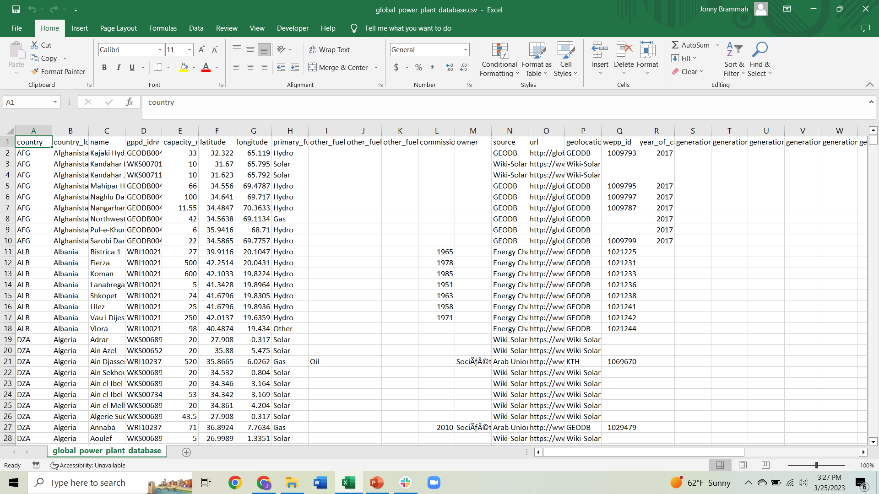
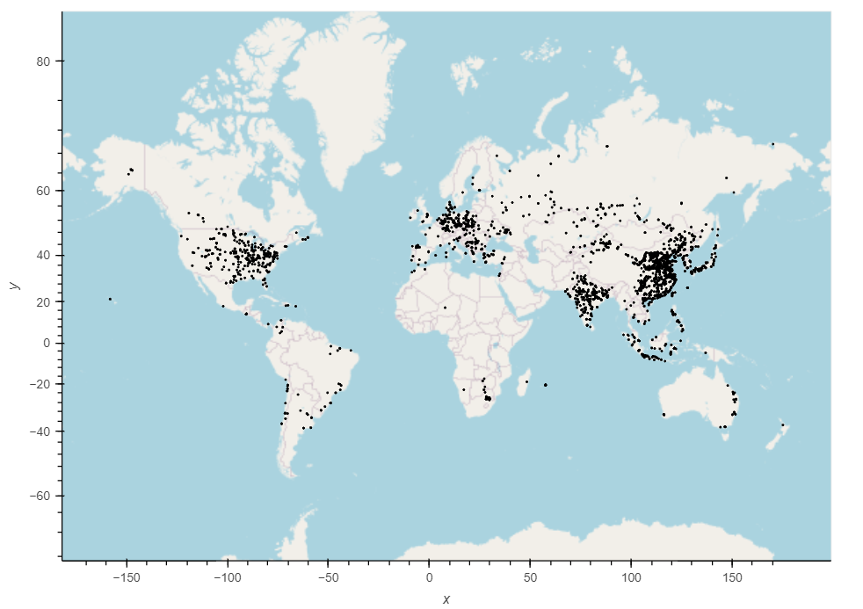
Global: Does the location of power plants across the world follow any particular pattern?
Data analysis:
The csv file already contained latitude and longitude so we were able to use hvplot to plot these
Notes:
Sophia

Slide 7
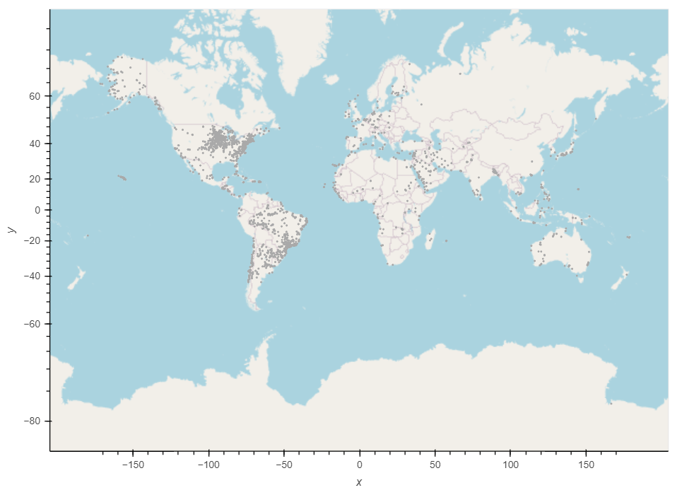
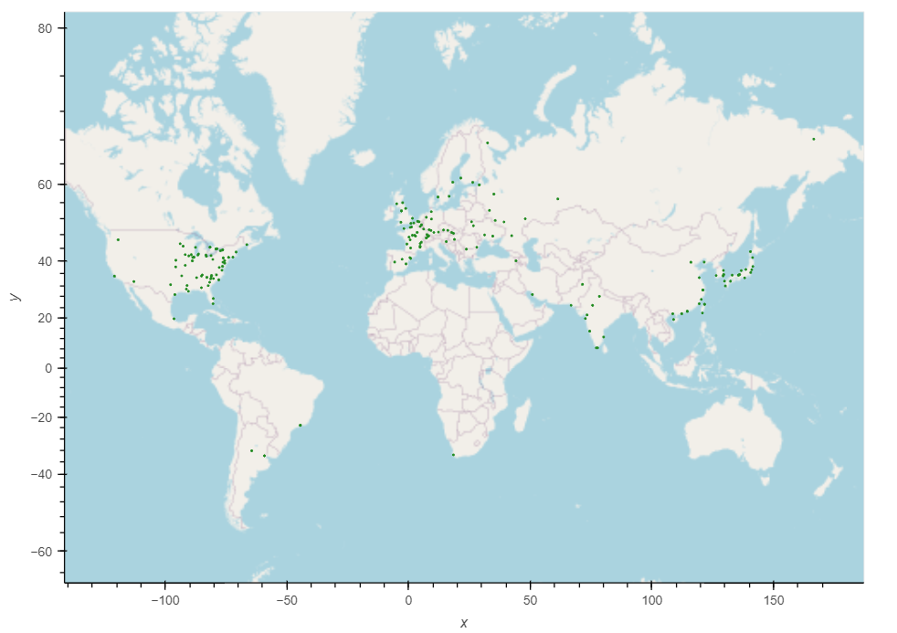
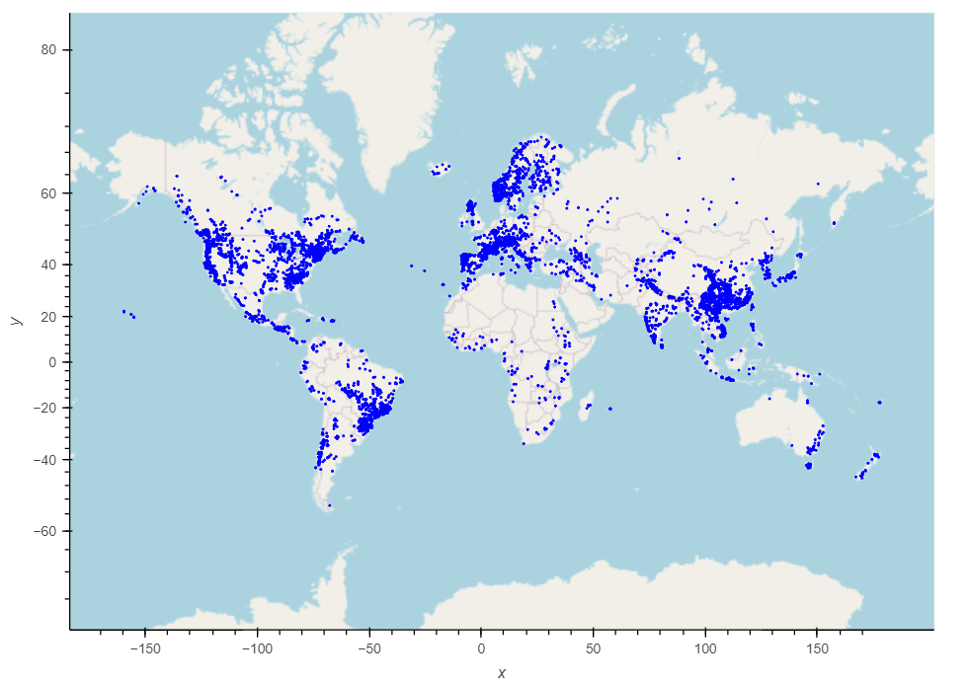
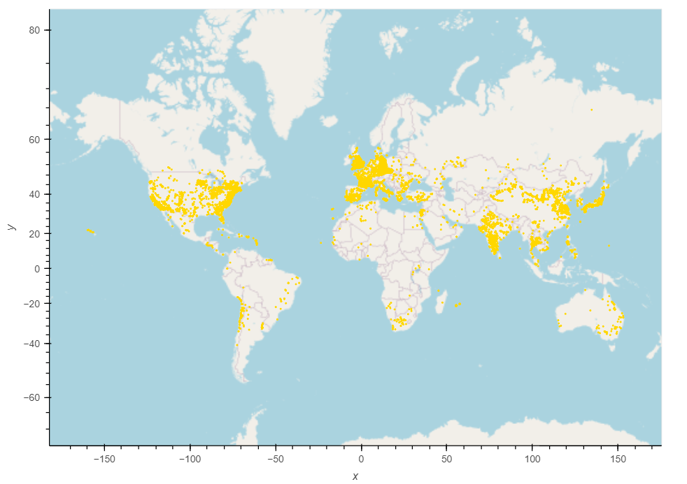
Global: Does the location of power plants across the world follow any particular pattern?
Solar
Hydroelectric
Nuclear
Natural Gas
Latitude
Coal
Longitude
Notes:
Attach lat and long labels to these graphs
Sophia

Slide 8

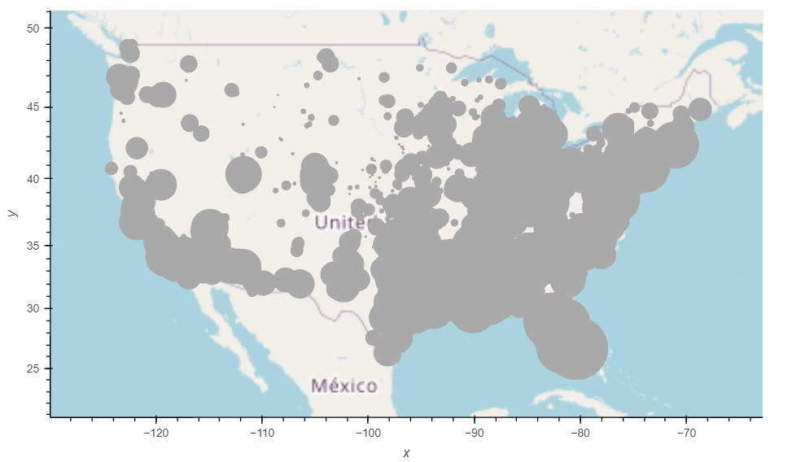
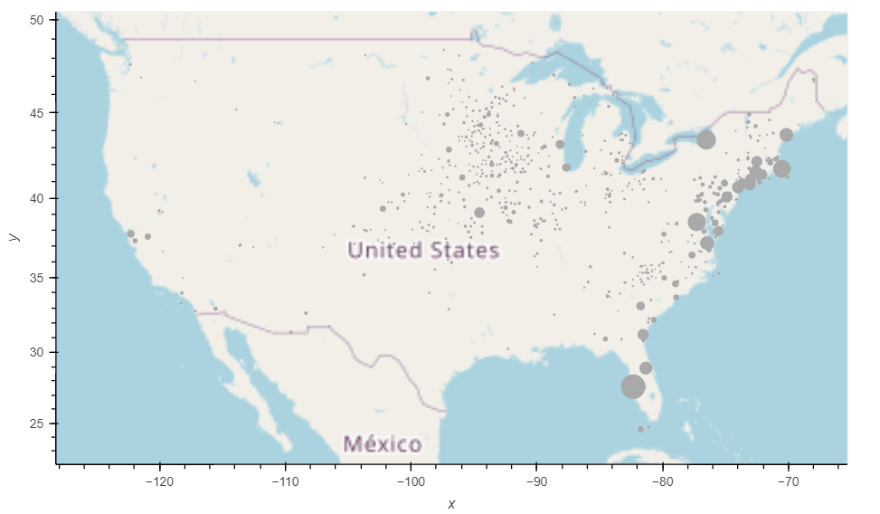
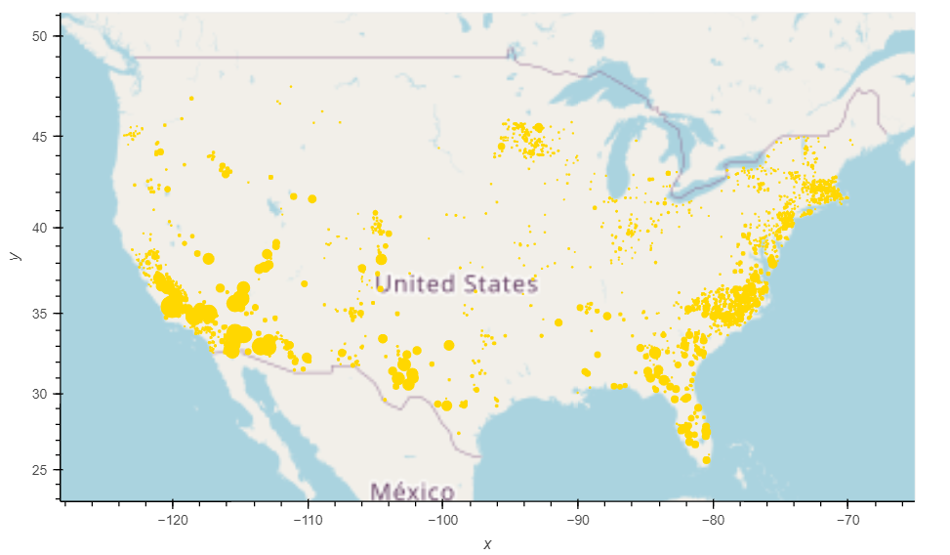
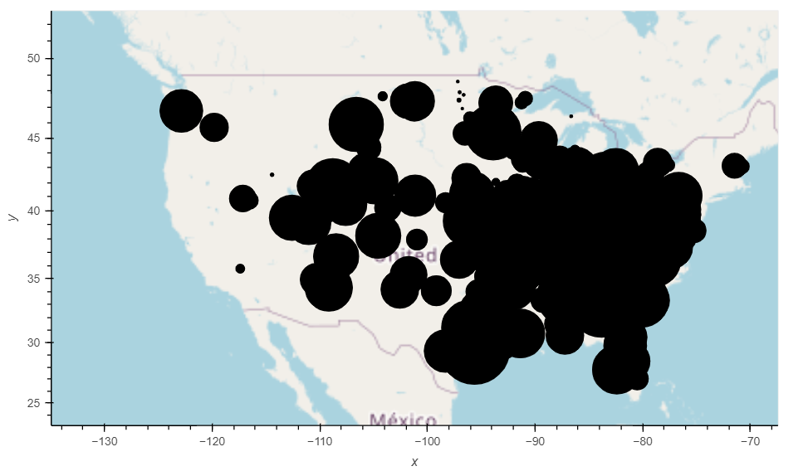
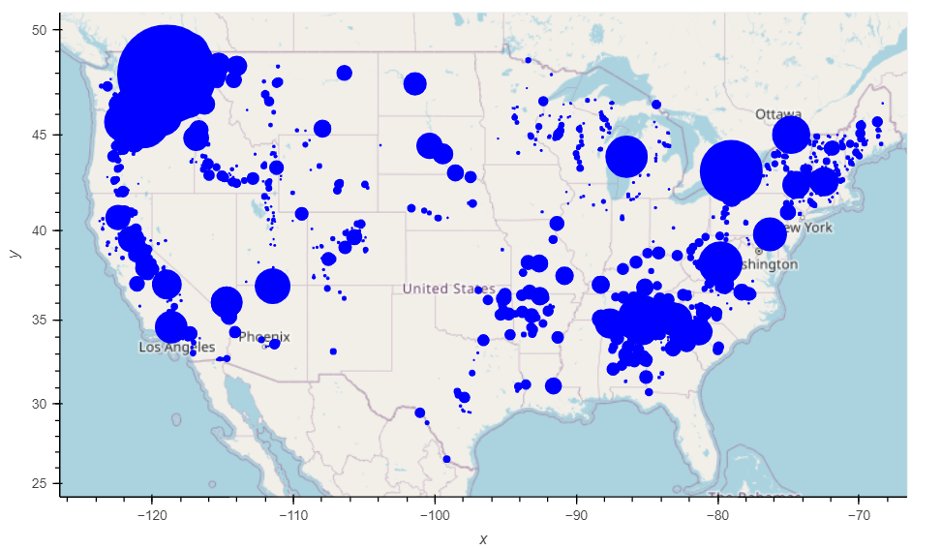
National: Does the location of power plants across the USA follow any particular pattern?
Solar
Hydroelectric
Oil
Coal
Latitude
Latitude
Latitude
Latitude
Latitude
Natural Gas
Longitude
Longitude
Longitude
Longitude
Longitude
Notes:
Sophia
Attach lat and long labels to these graphs

Slide 9


National: What fuel sources is the US using to generate electricity? How has this changed over time (if at all)?
Data analysis:
For this we used the Energy Information Agency API to pull data from 1990 to 2020 that contained:
Every power plant in a state by fuel type
How much energy that power plant produced that year
We could then sum by fuel type per year for every state
Notes:
Sophia

Slide 10
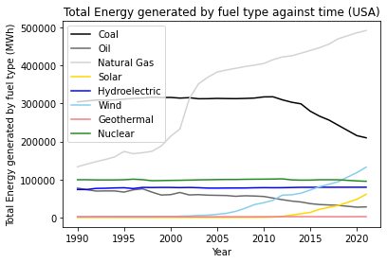
National: What fuel sources is the US using to generate electricity? How has this changed over time (if at all)?
Notable points:
Natural gas use increased significantly around 2000
Coal use started dipping just after 2010
Wind as a power source started to gain traction around 2005
Solar use didn’t really start until the early 2010s
Notes:
Sophia

Slide 11
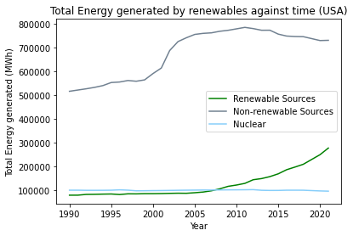
National: What fuel sources is the US using to generate electricity? How has this changed over time (if at all)?
Notable points:
More electricity is being generated by renewable sources since the mid-2000s but production from non-renewable sources are relatively stable
Notes:
Sophia

Slide 12

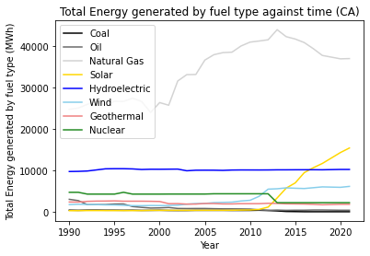
Statewide: What fuel sources is the CA using to generate electricity? How has this changed over time (if at all)?
Notable points:
California’s story is similar to the national story, but with a higher emphasis on solar power
You can see in 2012 when CA closed it’s second-to-last nuclear power plant
Notes:
Sophia

Slide 13
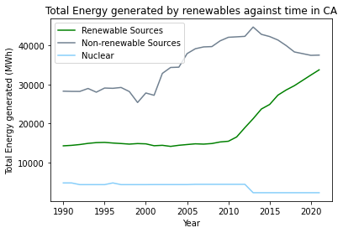
Statewide: What fuel sources is the CA using to generate electricity? How has this changed over time (if at all)?
Notable points:
California’s story is similar to the national story, but with a higher emphasis on solar power
You can see in 2012 when CA closed it’s second-to-last nuclear power plant
Notes:
Sophia

Slide 14
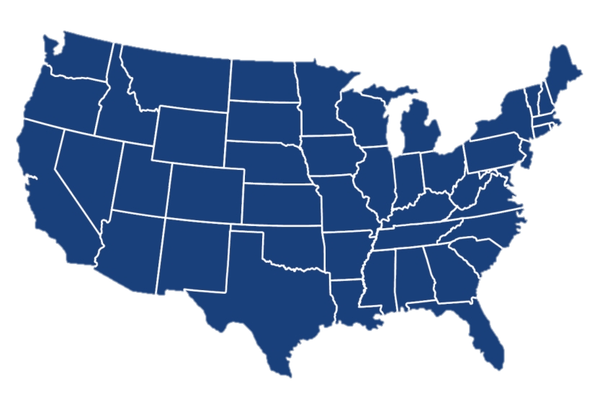

Statewide: Does the percentage of electricity generated by fossil fuels impact CO₂ emissions the state produces and price of electricity?
Data analysis:
For this we collected more data from the EIA to find:
CO₂ released by that state per year by electricity generation
Cost of electricity to residents
We normalized the CO₂ released by population data (taken from the US Census) to get CO₂ produced per person to plot these factors
Notes:
Jonny

Slide 15
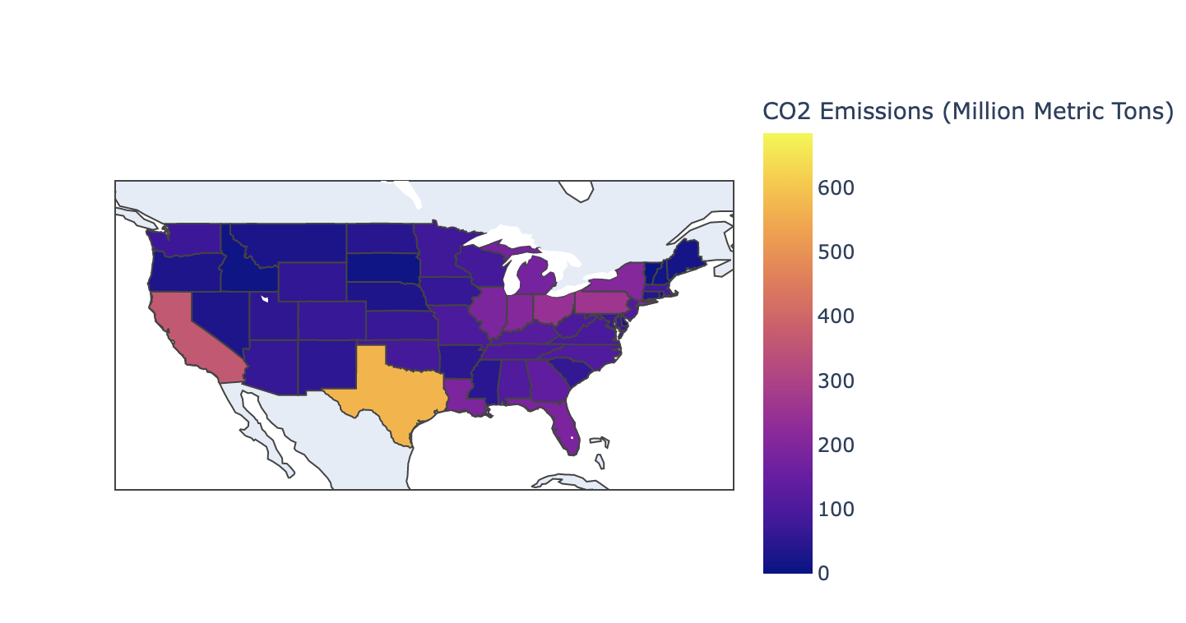
Statewide: Does the percentage of electricity generated by fossil fuels impact CO₂ emissions the state produces?
Notes:
Jonny

Slide 16
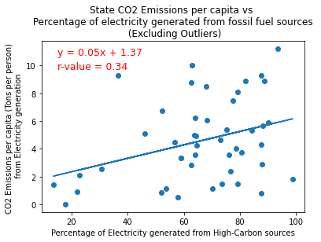
Statewide: Does the percentage of electricity generated by fossil fuels impact CO₂ emissions the state produces?
Hypothesis:
We hypothesized a strong correlation between percentage of electricity generated from fossil fuels and CO2 emissions per capita.
Results:
There is a correlation between how much energy is generated from high-carbon sources and the CO2 generated by the state during electricity production but it is not as strong as we expected (r = 0.34)
Note: Data for year 2020
Notes:
Jonny

Slide 17
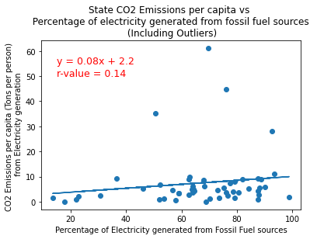
Statewide: Does the percentage of electricity generated by fossil fuels impact CO₂ emissions the state produces?
Hypothesis:
We hypothesized a strong correlation between percentage of electricity generated from fossil fuels and CO2 emissions per capita.
WY
Results:
There is a correlation between how much energy is generated from high-carbon sources and the CO2 generated by the state during electricity production but it is not as strong as we expected (r = 0.34)
VA
ND
WV
Note: Data for year 2020
Notes:
Jonny

Slide 18
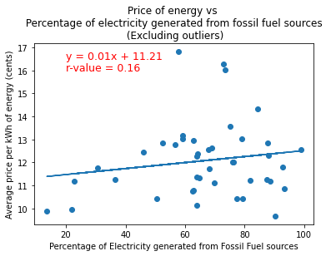
Statewide: Does the percentage of electricity generated by fossil fuels impact price of electricity to consumers?
Hypothesis:
We hypothesized that state’s which have a higher percentage of electricity generated from fossil fuels would have cheaper costs to residents.
Results:
The line of best fit implies that States with higher percentages of electricity from fossil fuel sources actually pay higher amounts per kWh of energy, but the correlation is very close to zero (r = 0.16)
Note: Data for year 2020
Notes:
Jonny

Slide 19
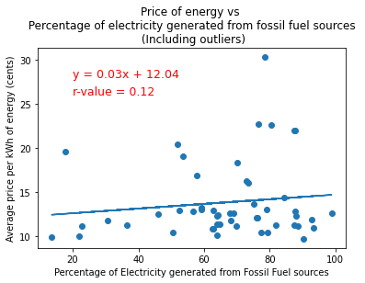
Statewide: Does the percentage of electricity generated by fossil fuels impact price of electricity to consumers?
Hypothesis:
We hypothesized a negative correlation between percentage of electricity generated from fossil fuels and price a state’s residents pay for electricity.
Results:
The line of best fit implies that States with higher percentages of electricity from fossil fuel sources actually pay higher amounts per kWh of energy, but the correlation is very close to zero (r = 0.16)
Note: Data for year 2020
Notes:
Jonny

Slide 20
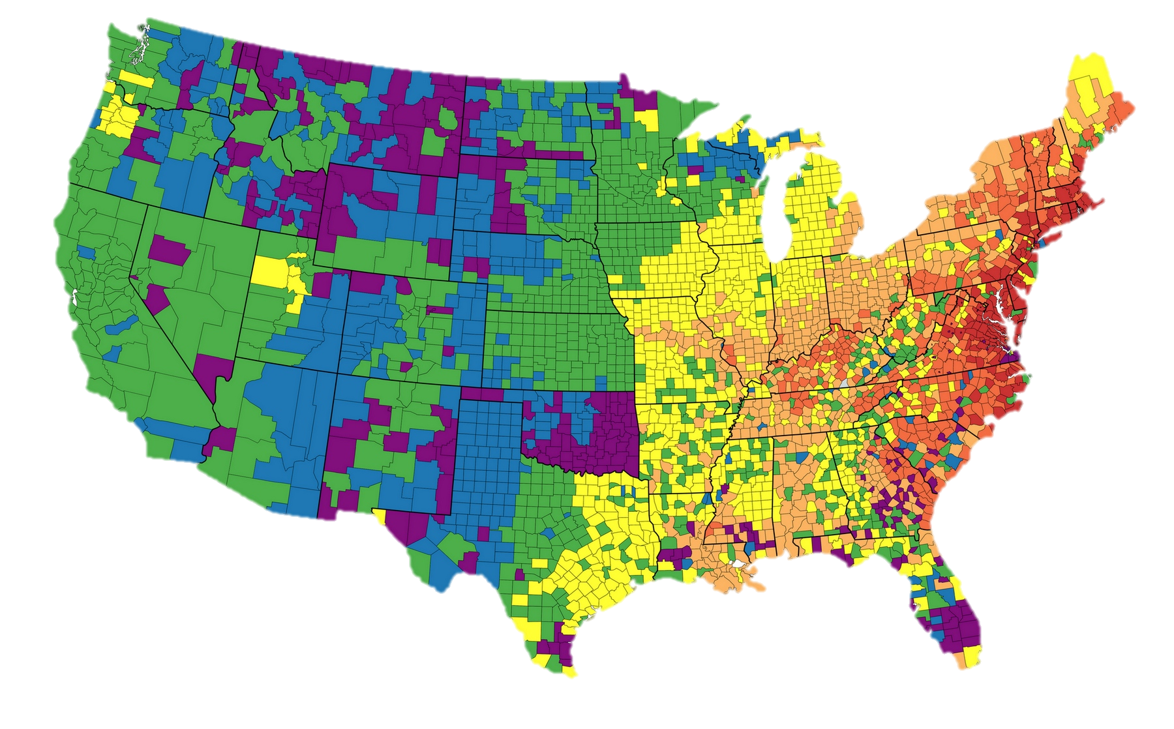

By county: Does the number of combustion-powered plants in a county correlate with air quality in that county and median income in that county?
Data analysis:
For this we used the location data from the initial csv file, and transformed the latitude and longitude to tell us the county where the plant is located.
We merged this with data:
from the EPA to tell us the Air Quality statistics for each county
from the US Census to tell us the median income for each county
Notes:
Sophia

Slide 21
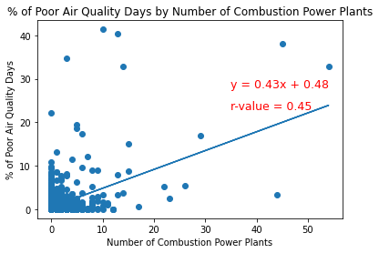
By county: Does the number of combustion-powered plants in a county correlate with air quality in that county?
Hypothesis:
We hypothesized a strong correlation between the number of combustion-powered plants and the percentage of days with poor air quality in that county
Results:
The higher the number of combustion powered plants in a county, the higher the percentage of poor air quality days.
The correlation isn’t as strong as we thought (r = 0.45) but this makes some sense because this isn’t controlling for traffic or other industry in that county
Note: Data for year 2017
Notes:
Sophia

Slide 22
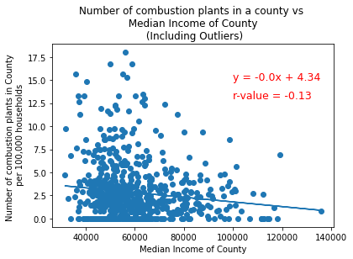
By county: Does the number of combustion-powered plants in a county correlate with median income in that county?
Hypothesis:
We hypothesized that there would be a correlation here, imagining people with lower median incomes are more likely to live near more combustion powered plants
Results:
The results do indicate that more income generally correlates with fewer plants (normalized for number of households in the county)
But the correlation is also very weak here.
Note: Data for year 2017
Notes:
Sophia

Slide 23

Summary
In general, the findings didn’t really match up with our hypotheses. This was often due to assumptions we were making or an oversimplistic initial picture of energy generation, but has lead to interesting questions for further research.
Limitations and Assumptions:
Some of the data is a few years old and that might limit the relevance of our conclusions
External factors such as changes in regulations, policies, economic conditions are also not accounted for.
Future Scope:
We’d like to further analyze impacts of placement of power plants down to a zipcode level. The EPA analyses within 3 mile radii of power plants.
Impacts on energy production and consumption and climate change.
Identifying regions where renewable energy could be scaled up to meet energy demand sustainably.
Notes:
From Srabana’s Readme

Slide 24


Questions?

